Slide 1

Deep Learning 101:
Train a model with AlexNet
Data Science and Machine Learning Bootcamp
April 2018

Slide 2
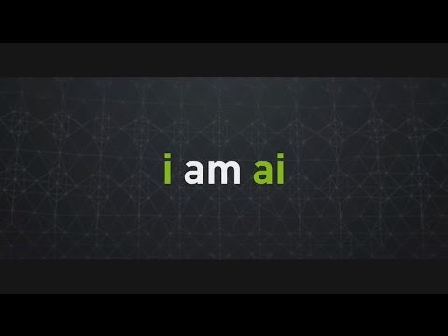
Watch a video from Nvidia’s GTC opening keynote
Notes:
Instructors: play the video even before the class starts to get attractions!

Slide 3
All the applications you just watched are boosted
by DEEP LEARNING!

Slide 4
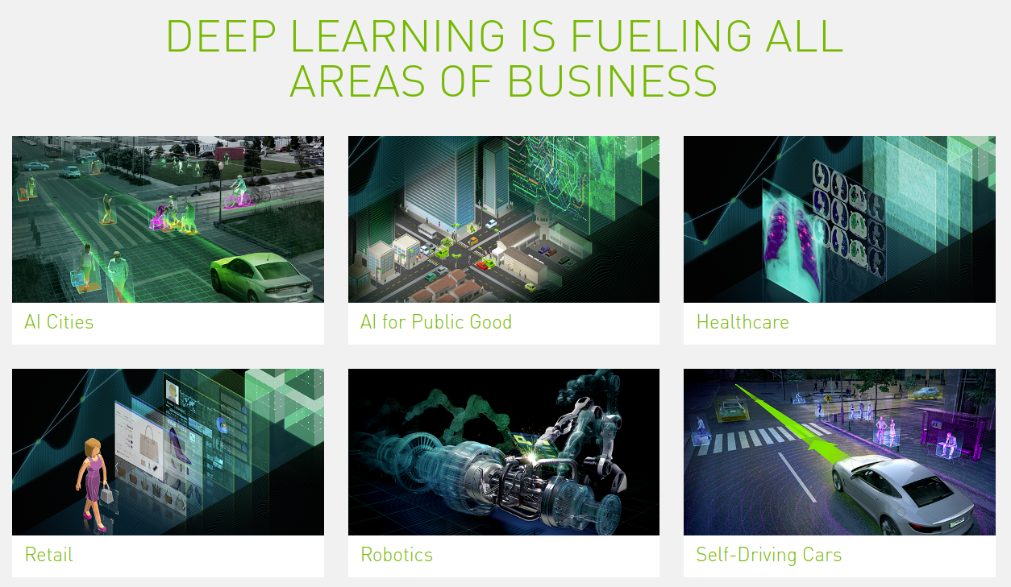

Slide 5
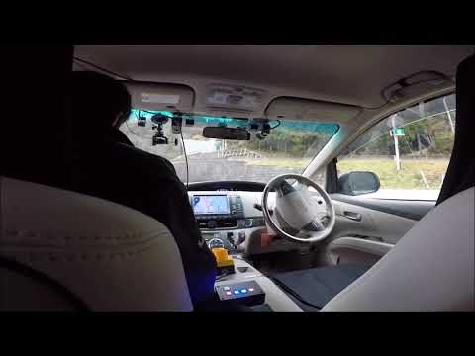

Deep learning in the wild:
Self-driving cars
Question:
What kind of tasks (object detection for instance) are involved in self-driving cars?
Source: https://www.autoware.ai/

Slide 6
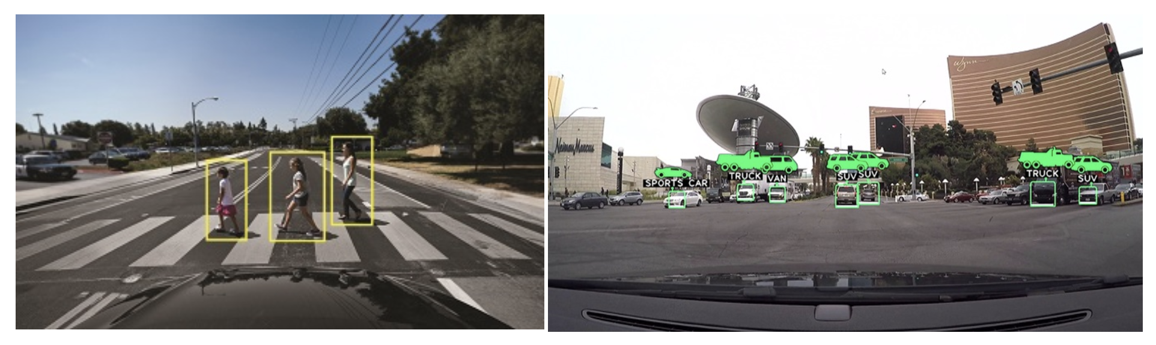
Deep learning in the wild:
Self-driving cars
Detection task
includes sensor processing, sensor correlation, sensor fusion, segmentation, detection and classification.
Source: https://developer.nvidia.com/driveworks

Slide 7
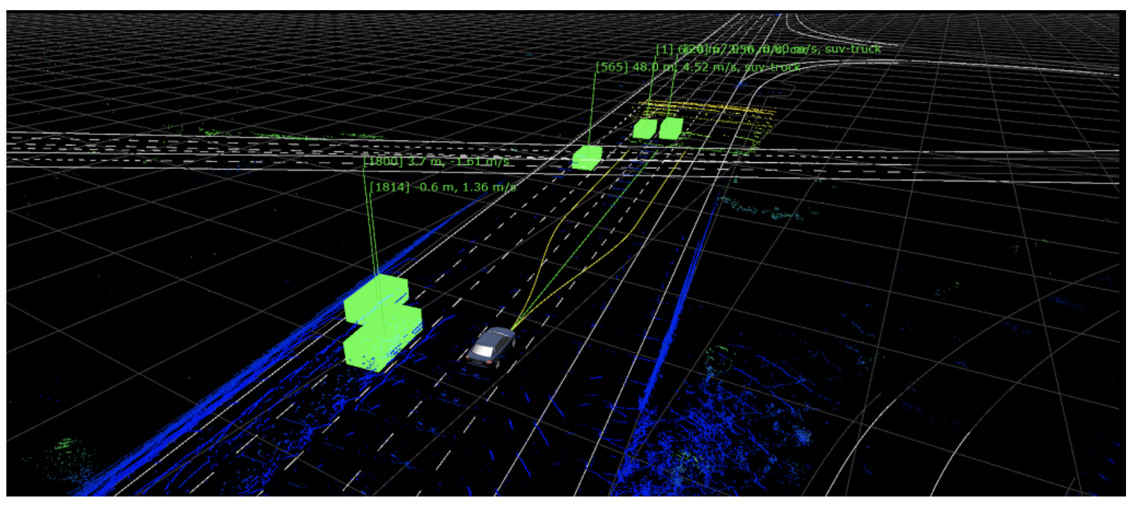
Deep learning in the wild:
Self-driving cars
Localization task
includes map localization, HD-Map interfacing, and egomotion (structure from motion and odometry)
Source: https://developer.nvidia.com/driveworks

Slide 8
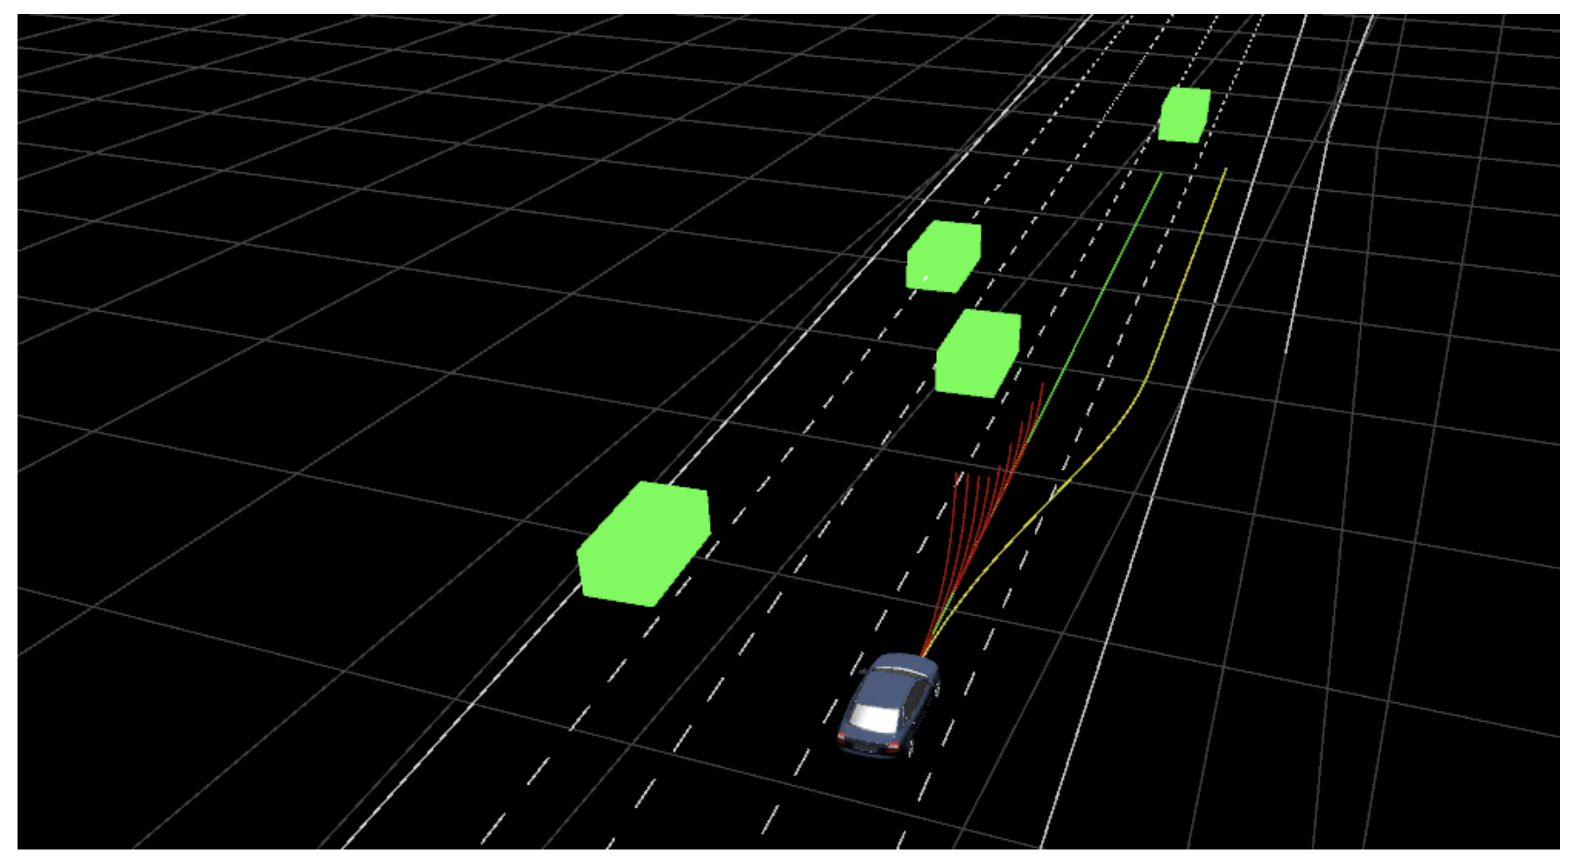
Deep learning in the wild:
Self-driving cars
Planning task
includes vehicle control, scene understanding and path planning problem solvers
Source: https://developer.nvidia.com/driveworks

Slide 9
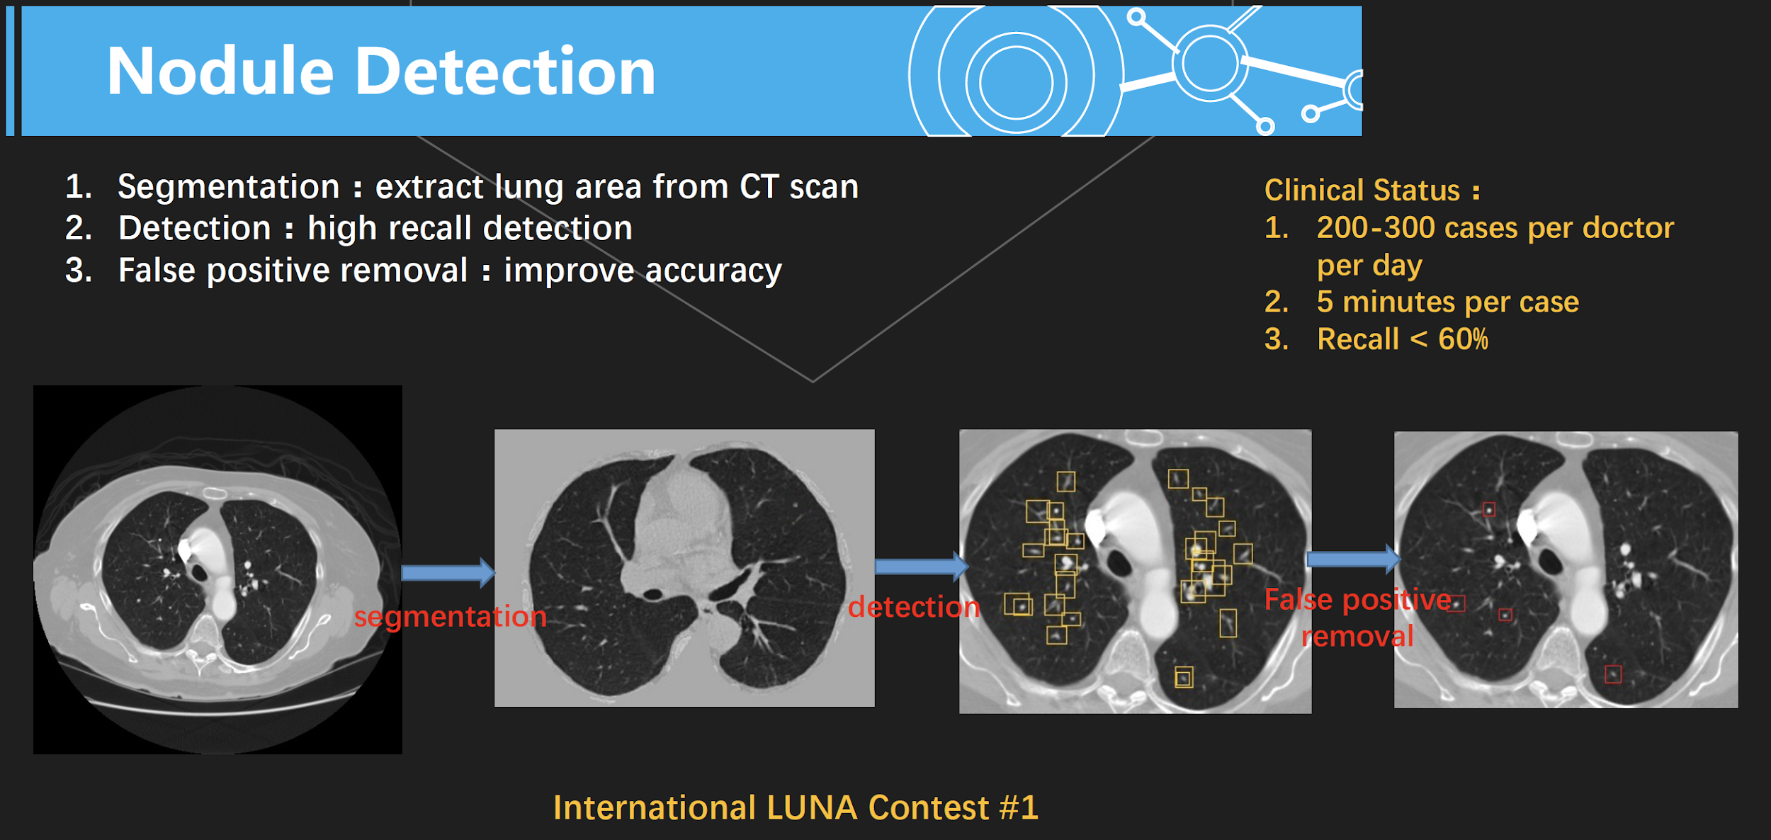
Deep learning in the wild:
Healthcare At GTC, Taking the Pulse of How AI is Transforming Healthcare

Slide 10
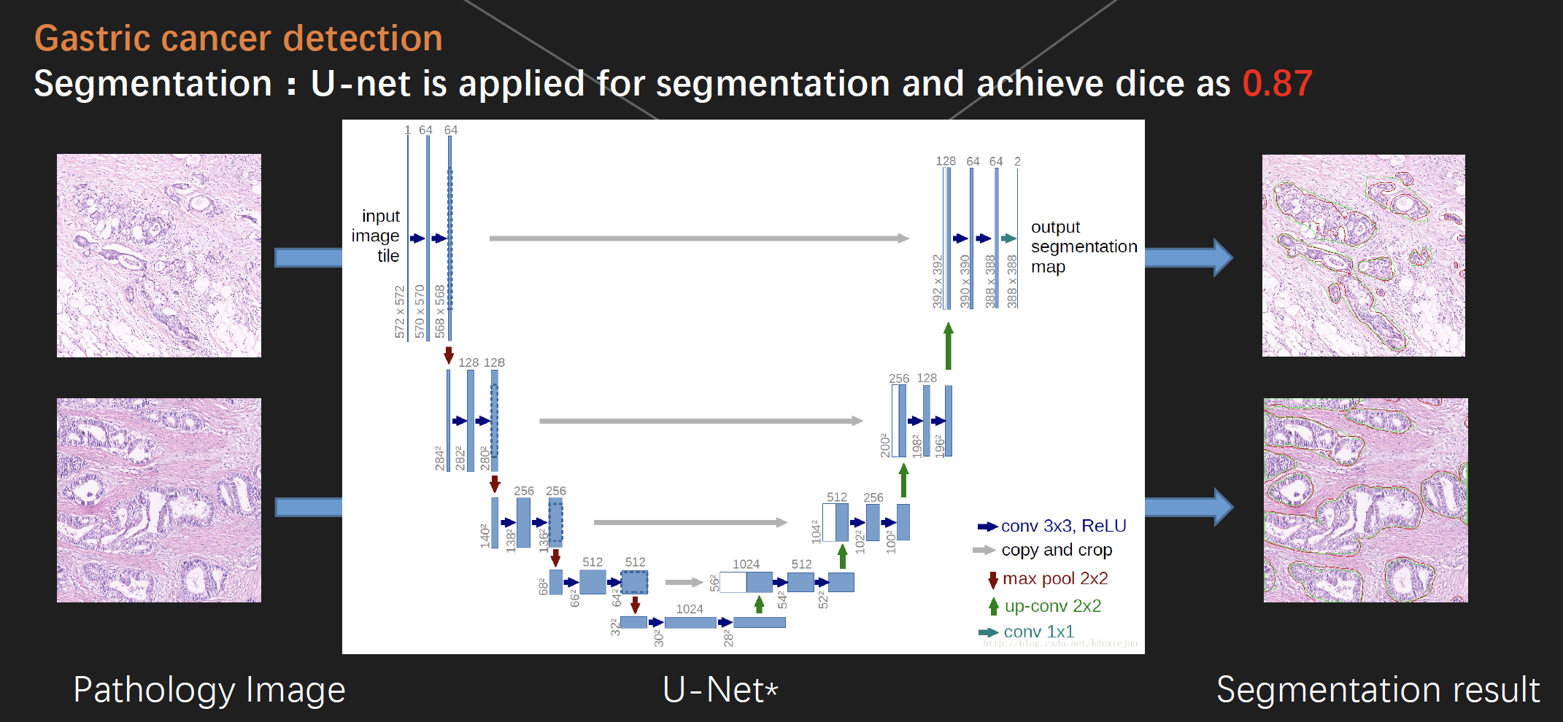
Deep learning in the wild:
Healthcare

Slide 11
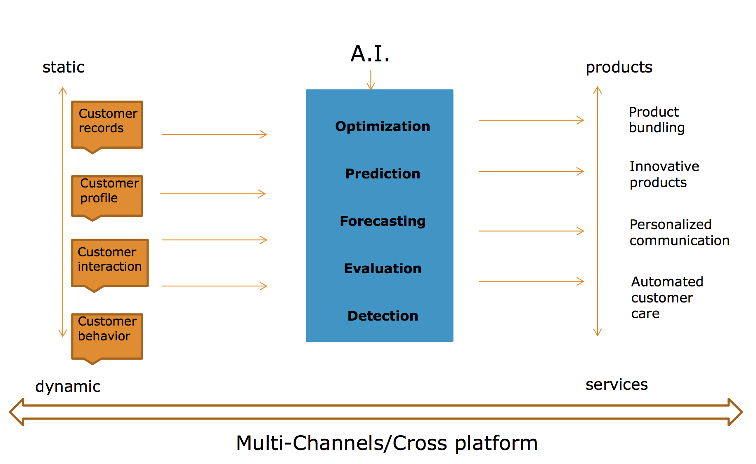
Deep learning in the wild:
AI in Finance

Slide 12
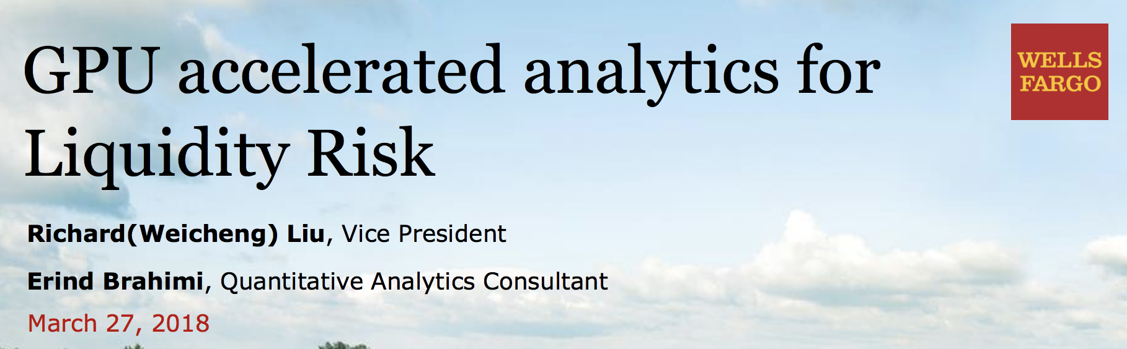
Deep learning in the wild:
AI in Finance
Balance models
Video: http://on-demand.gputechconf.com/gtc/2018/video/S8754/

Slide 13
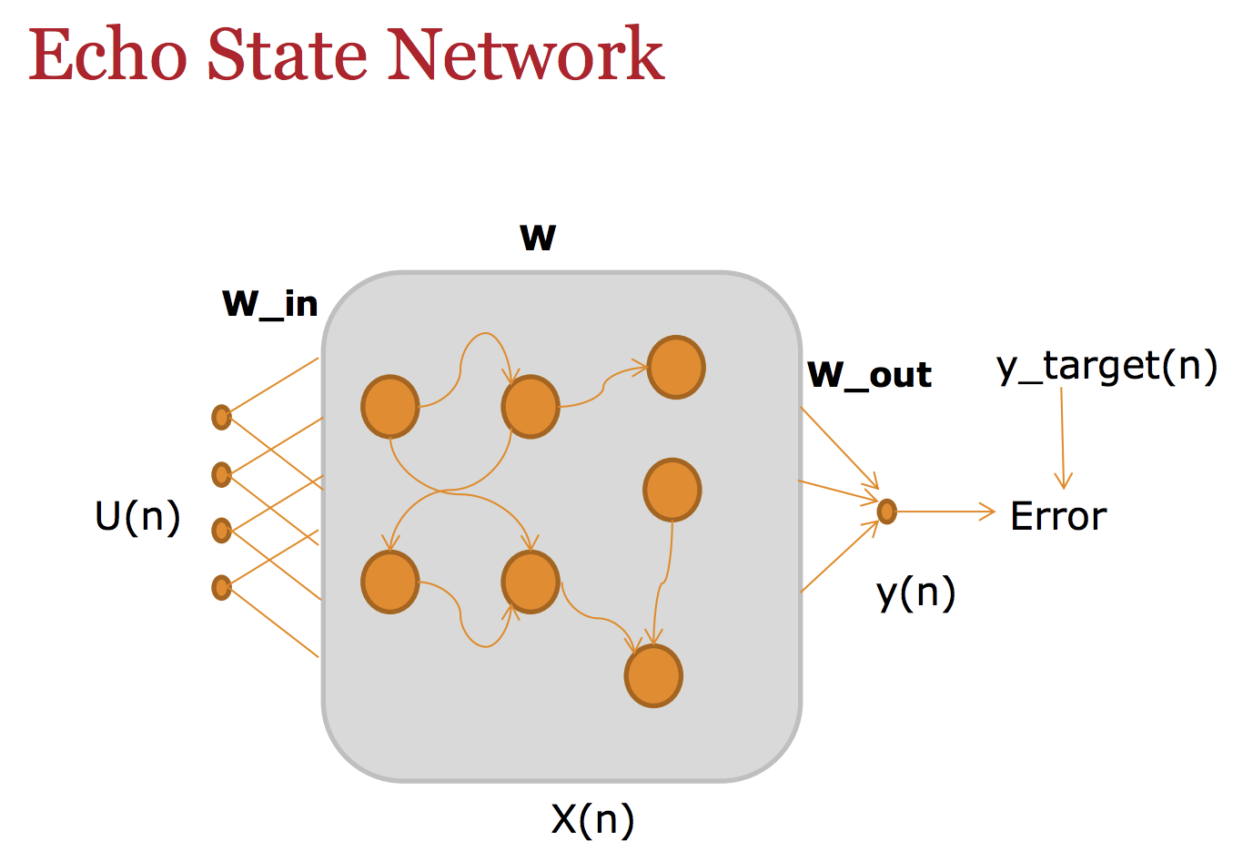
Deep learning in the wild:
AI in Finance
Balance models
Goal: models the effect of macroeconomic conditions on the balance of a portfolio
Challenges:
Size of account/transaction data
Complex underlying relationships at account level
Some expected econometric relationships at the bank portfolio level
Solution:
Slides link: http://on-demand.gputechconf.com/gtc/2018/presentation/s8754-gpu-accelerated-analytics-for-liquidity-risk.pdf

Slide 14
There are so many topics to be covered: deep learning for finance marketing, for image search products, for retailing, for education, for astronomy, etc.
Examples shown above are just a tiny piece of the whole picture.

Slide 15
Deep Learning is hot!
So let's get down to it!

Slide 16
This Week's Outline
1. Introduction
2. Prerequisite to machine learning, optimization
3. Convolution neural networks (core theory part)
4. Useful softwares/tools/resources
5. Train an image classifier with PyTorch (core application)
6. Experiments, open discussions and extensions
First session stops here

Slide 17
This Week's Outline
1. Introduction
2. Prerequisite to machine learning, optimization
3. Convolution neural networks
4. Useful softwares/tools/resources
5. Train an image classifier with PyTorch
6. Experiments and open discussions

Slide 18
What is "deep learning", anyway?

Slide 19
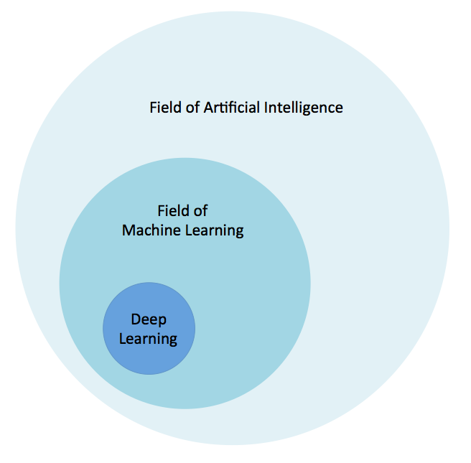
Introduction
Deep learning is a specific subset of Machine Learning, which is a specific subset of Artificial Intelligence. For individual definitions:
+ Artificial Intelligence is the broad mandate of creating machines that can think intelligently
+ Machine Learning is one way of doing that, by using algorithms to glean insights from data (see our gentle introduction here)
+ Deep Learning is one way of doing that, using a specific algorithm called a Neural Network (convolutional/recurrent neural networks, capsules, echo state network, etc).

Slide 20
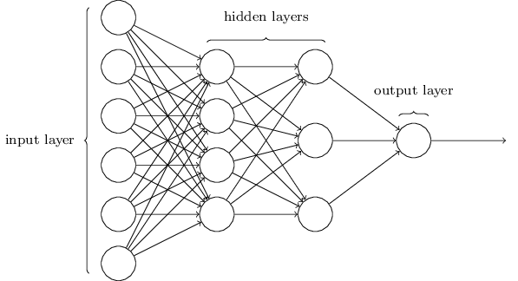
Neural network
Inspired by the structure of the cerebral cortex.
At the basic level is the perceptron, the mathematical representation of a biological neuron. Like in the cerebral cortex, there can be several layers of interconnected perceptrons.
Input values, or in other words our underlying data, get passed through this “network” of hidden layers until they eventually converge to the output layer. The output layer is our prediction: it might be one node if the model just outputs a number, or a few nodes if it’s a multiclass classification problem.
Each circle represents a "neuron". It is in form of scale or vector.
Their connections are indicated by the weights among them.
how the weights are updated?
Backpropagation!
(we will quickly recap what it is later)

Slide 21
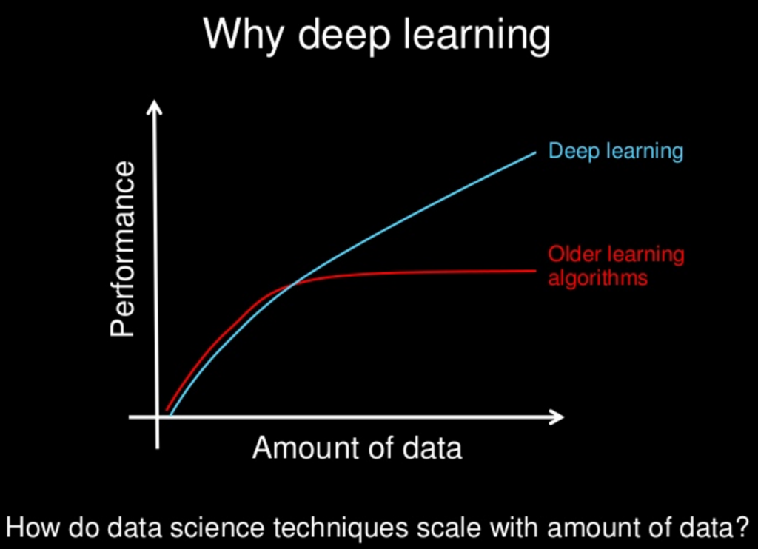
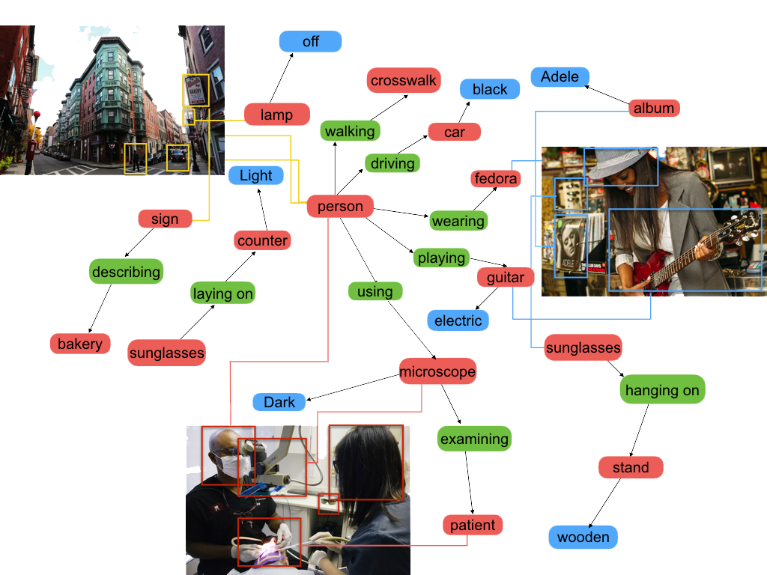
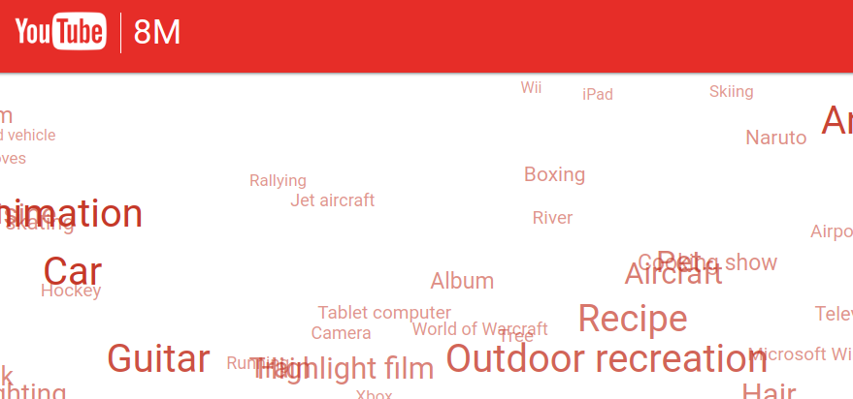
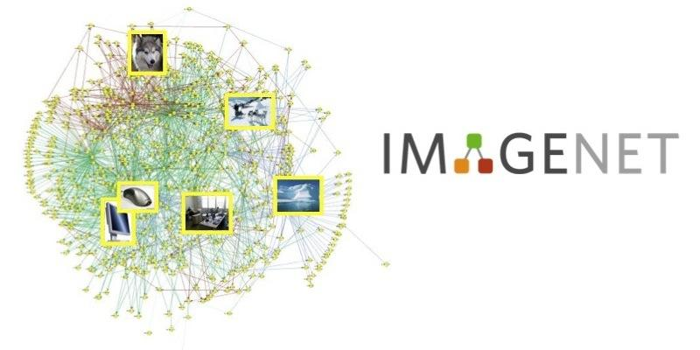
Why deep learning?
How do data science techniques scale with the amount of data?
Older learning algorithms:
SVM, k-NN (nearest neighbor), logistic regression, etc.
The reason why DL is superior than previous methods is that DL provides better feature representation through the explicit learning of vast amount of data; while traditional methods suffer from such an advantage since their representation is limited due to small model complexity.
VisualGenome
YouTube-8M
ImageNet
Thanks to the research community, we really got the large-scale datasets in various domain. For example, in computer vision --->
Notes:
(the explanation is a little bit hard if you are not familiar with machine learning basics.)
Instructors can explain it via concrete examples in SVM vs DL.

Slide 22
This Week's Outline
1. Introduction
2. Prerequisite to machine learning, optimization
3. Convolution neural networks
4. Useful softwares/tools/resources
5. Train an image classifier with PyTorch
6. Experiments and open discussions

Slide 23
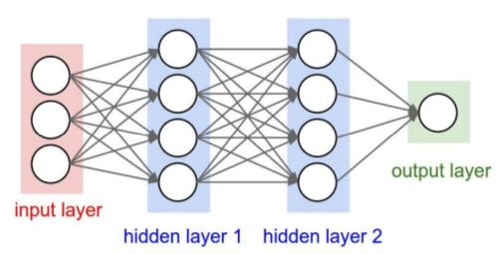
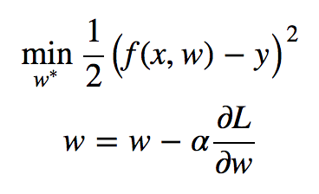
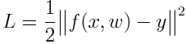
ML Recap - Supervised learning
Once upon a time, there is a network whose ultimate goal is to find a set of parameters W to minimize the following loss:
x is the input; f(x, w) is a mapping function through input to output. y is the target output.
This "y" information is why we call such an optimization problem as supervised learning.
how to minimize the object function above?
- if f is a simple quadratic function
- if f is a complex non-convex function: most DL tasks falls into this category.
Solution: (stochastic, why?) gradient descent!
Notes:
Instructors should illustrate the gradient descent method via a simple quadratic function case. e.g., y = x^2.

Slide 24
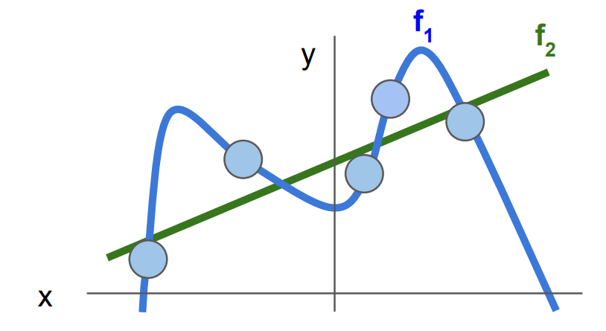
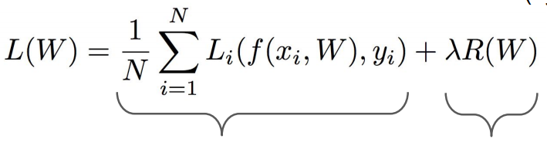
ML Recap - Loss function
Once upon a time, there is a network whose ultimate goal is to find a set of parameters W to minimize the following loss:
Actually, the final loss in deep learning is:
data loss: model predictions should match training data
regularization: prevent the model from doing too well on training data
Notes:
Some examples:
L1/L2, dropout, batch normalization, stochastic depth
why regularize?
- Express preferences over weights
- Make the model simple so it works on test data
- Improve optimization by adding curvature

Slide 25
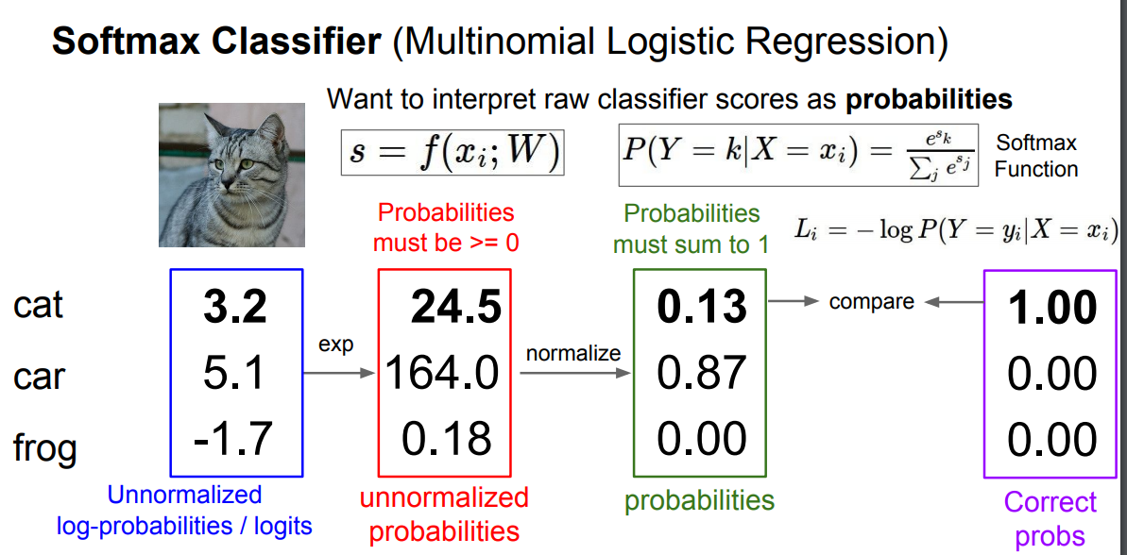
ML Recap - Loss function
If the loss is a multinomial logistic regression:
the softmax function is: , the network s= f(x_i; W)
Question: compute the loss given the following network output.

Slide 26
ML Recap - Loss function
If the loss is a multinomial logistic regression:
the softmax function is: , the network s= f(x_i; W)
Question: compute the loss given the following network output.

Slide 27
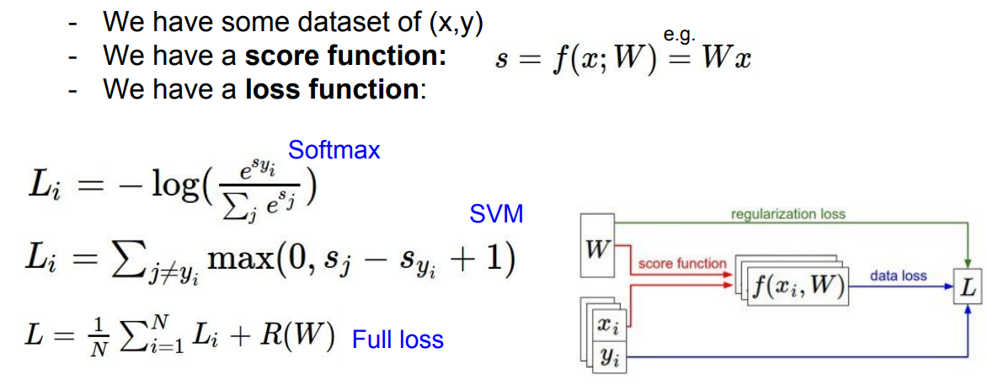
ML Recap - Summary till now
"i" is the index of data samples.

Slide 28
ML Recap - Gradient descent
Once upon a time, there is a network whose ultimate goal is to find a set of parameters W to minimize the following loss:
The network - called neural network (deep learning) - given input x, it will generate some vectorized outputs via a network f(x,W), the form of f can be various, e.g., f = Wx being the linear operation.
How to find the optimal W (update the network parameters)?
Gradient descent!
\alpha is learning rate
How to compute the gradient w.r.t loss is the core/key in DL.
Professionals should be super, super, and super crystal about this.

Slide 29
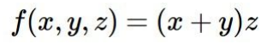
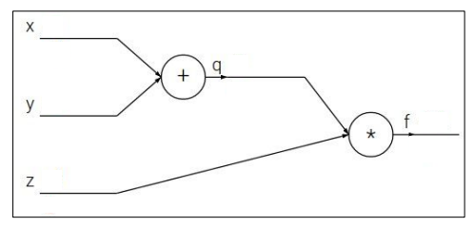
ML Recap - Compute
Short answer to compute the gradient: chain rule.
Backpropagation: a simple and important example.
given x = -2, y = 5, z = -4, how to compute the gradient w.r.t. each variable?

Slide 30
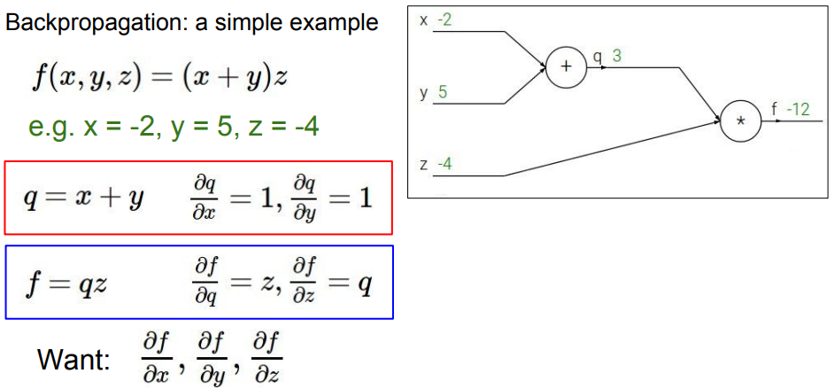
ML Recap - Compute

Slide 31
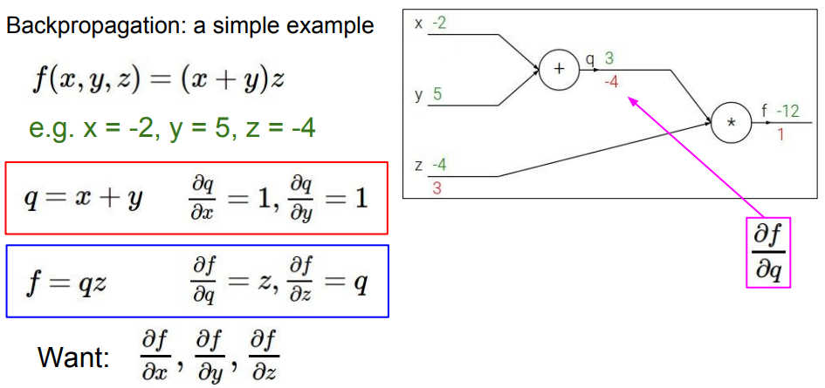
ML Recap - Compute

Slide 32
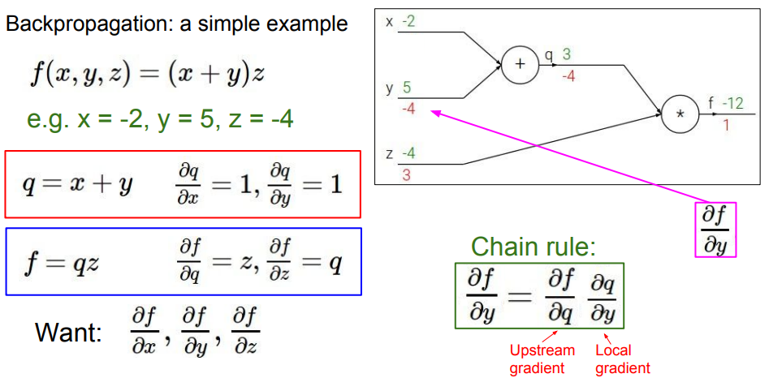
ML Recap - Compute

Slide 33
ML Recap - Compute
As practitioners, do we need to know exactly how to compute gradient of every and each single node in the graph?
Answer is no. Hooray! since most softwares (PyTorch/TensorFlow) has the mechanism called autograd to compute the gradients automatically for you.
http://pytorch.org/tutorials/beginner/former_torchies/autograd_tutorial.html (see example below)
x = Variable(torch.ones(2, 2), requires_grad=True) print(x) # notice the "Variable containing" line
y = x + 2
z = y * y * 3 out = z.mean()
out.backward() # do the back-prop! print(x.grad)

Slide 34
This Week's Outline
1. Introduction
2. Prerequisite to machine learning, optimization
3. Convolution neural networks
4. Useful softwares/tools/resources
5. Train an image classifier with PyTorch
6. Experiments and open discussions

Slide 35
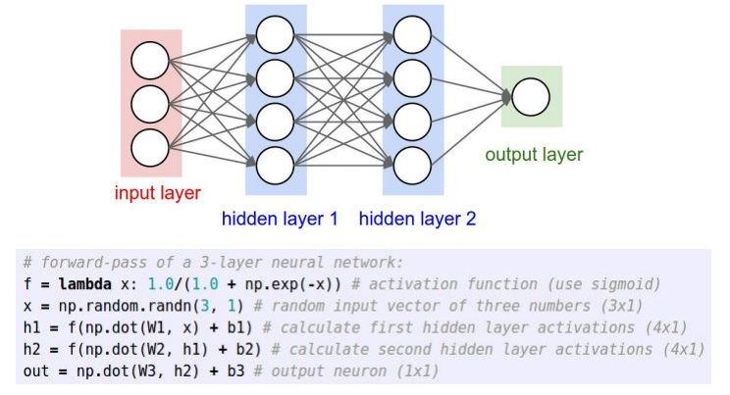
Fully connected neural networks
The following shows a simple feed-forward network with 2 hidden layers.

Slide 36
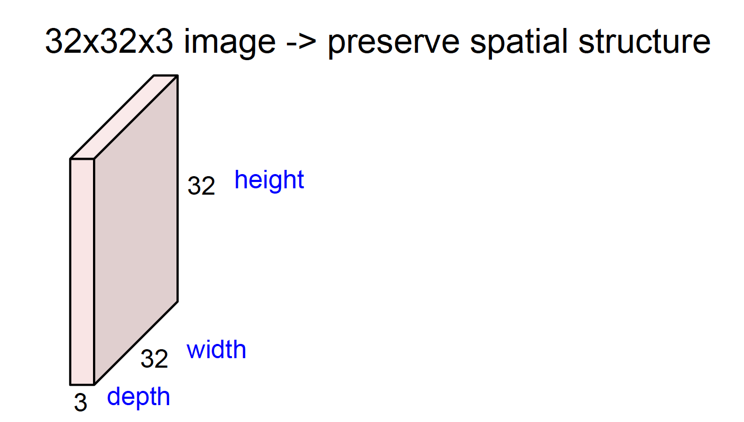
Convolution neural networks
This is the input image

Slide 37
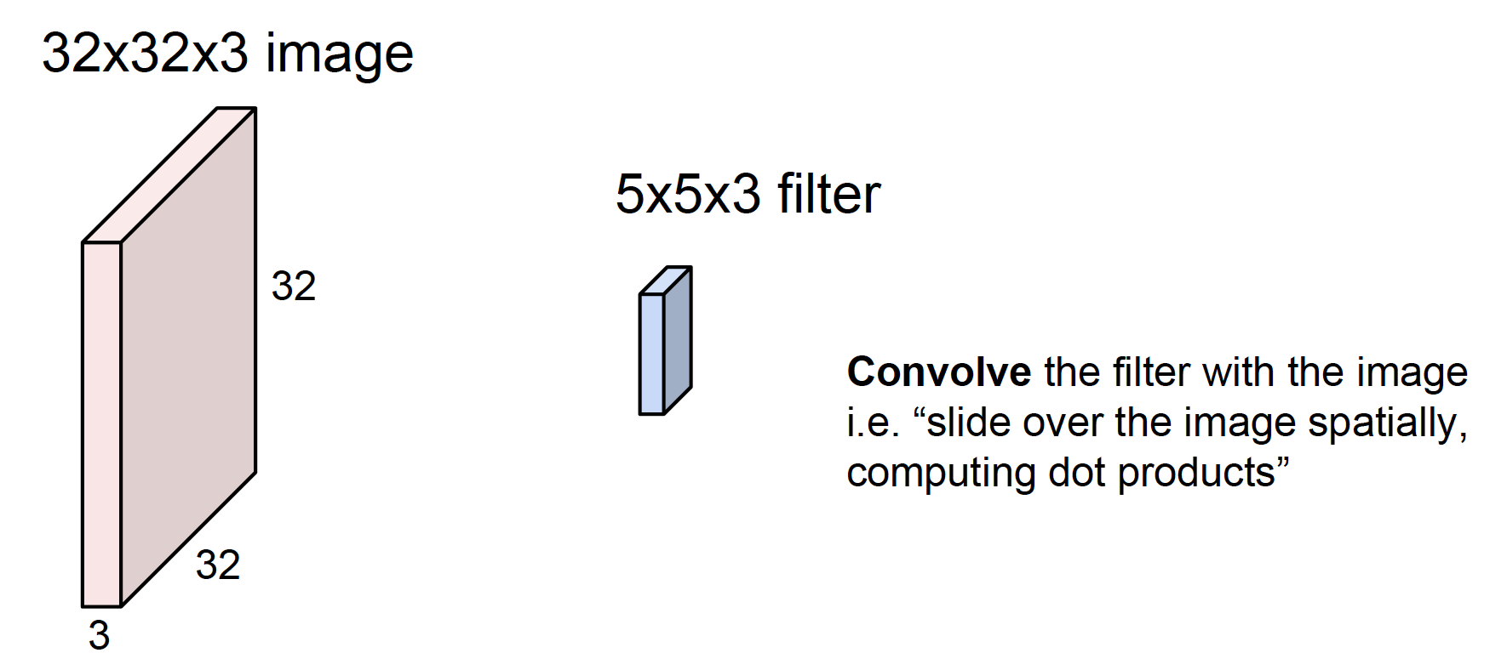
Convolution neural networks
Then we have a filter - sharing weights among different locations in the feature map/image (pink)

Slide 38
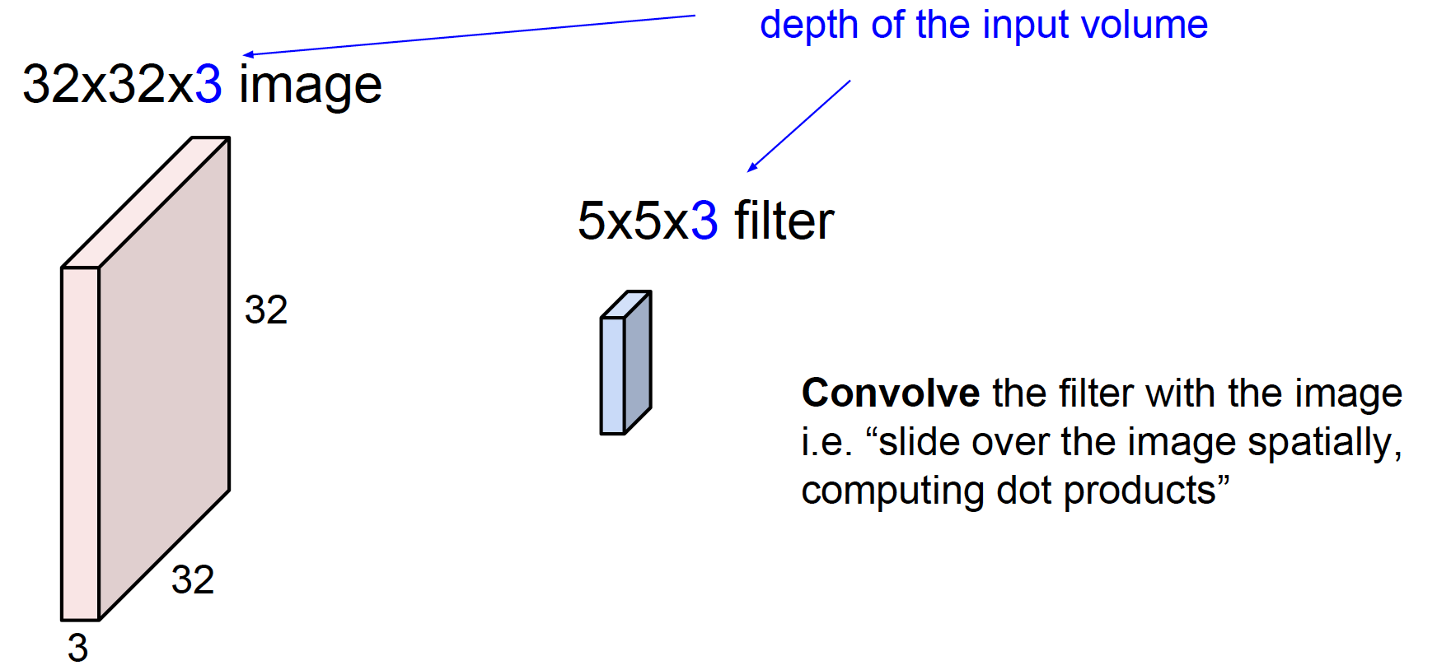
Convolution neural networks
Filters always extend the full

Slide 39
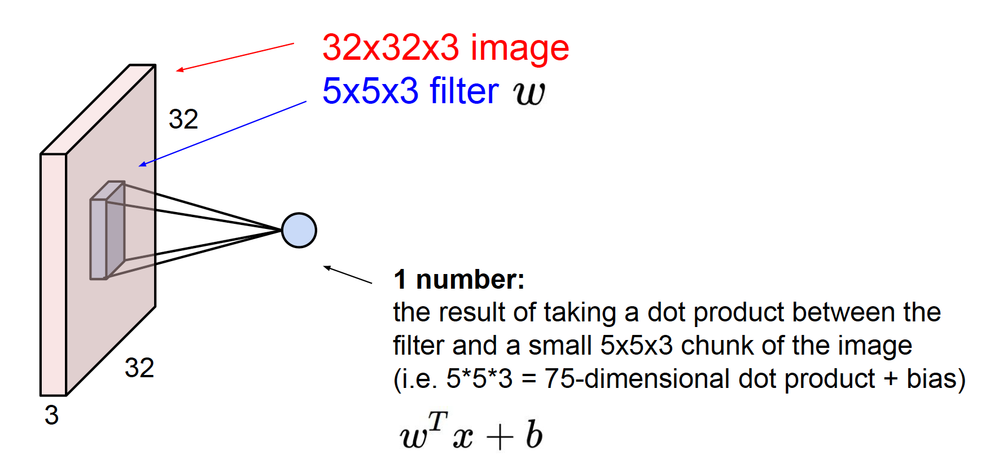
Convolution neural networks
What’s the output of such a convolution operation?

Slide 40
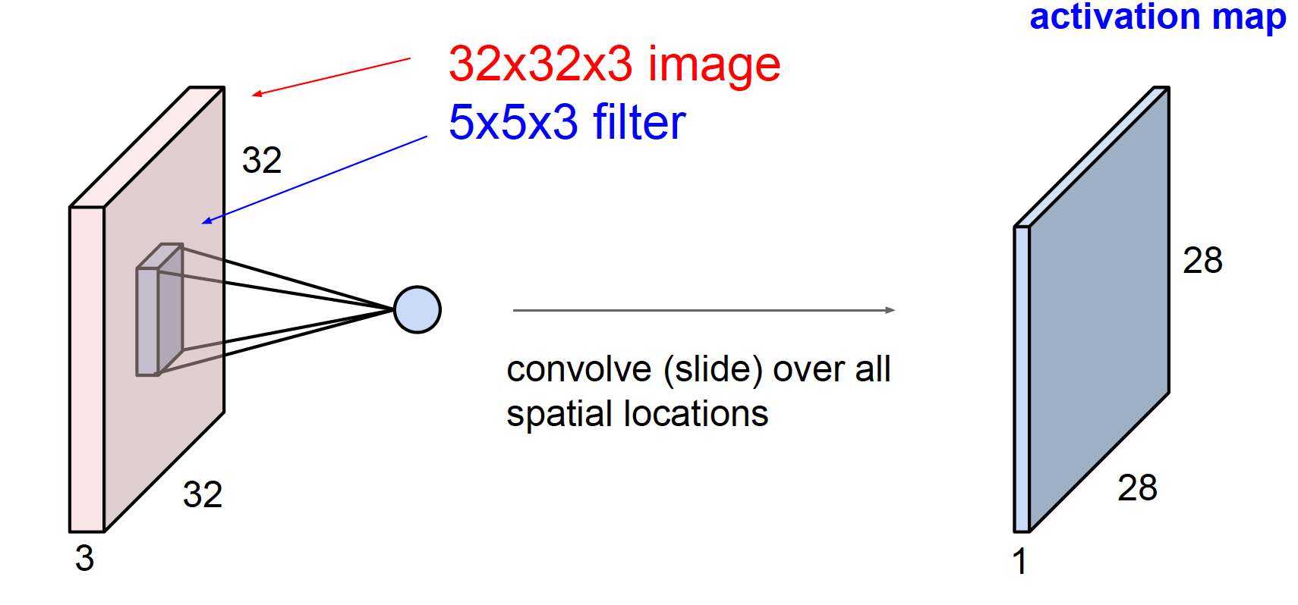
Convolution neural networks
Output!

Slide 41
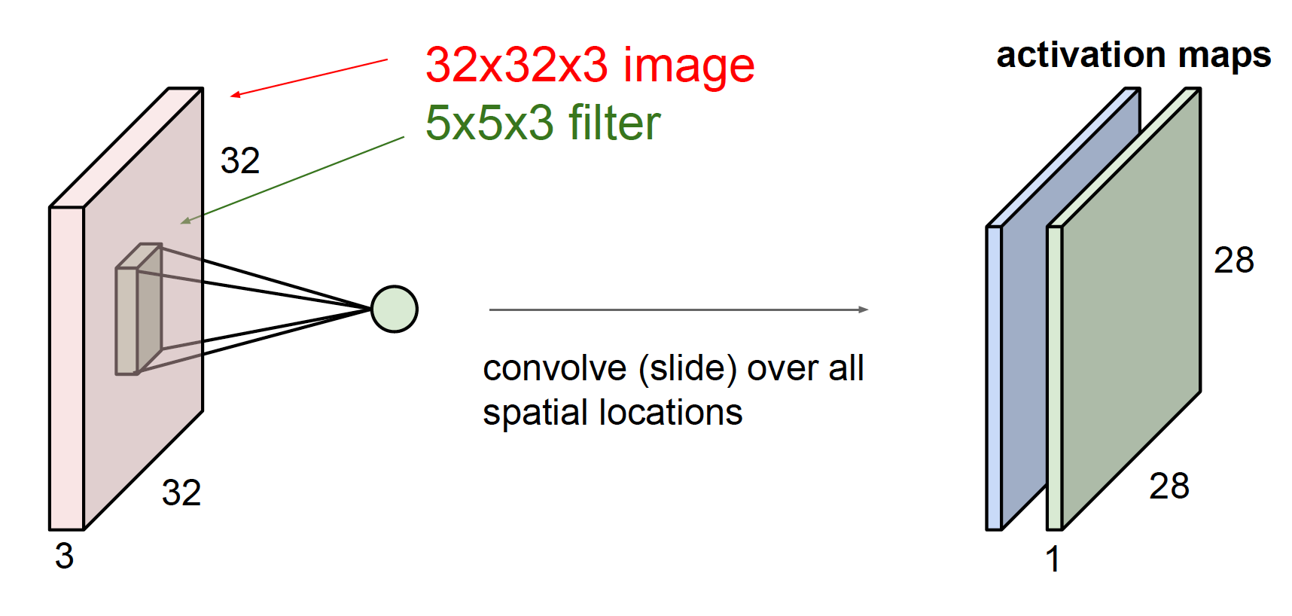
Convolution neural networks
Then we have another filter (green)

Slide 42
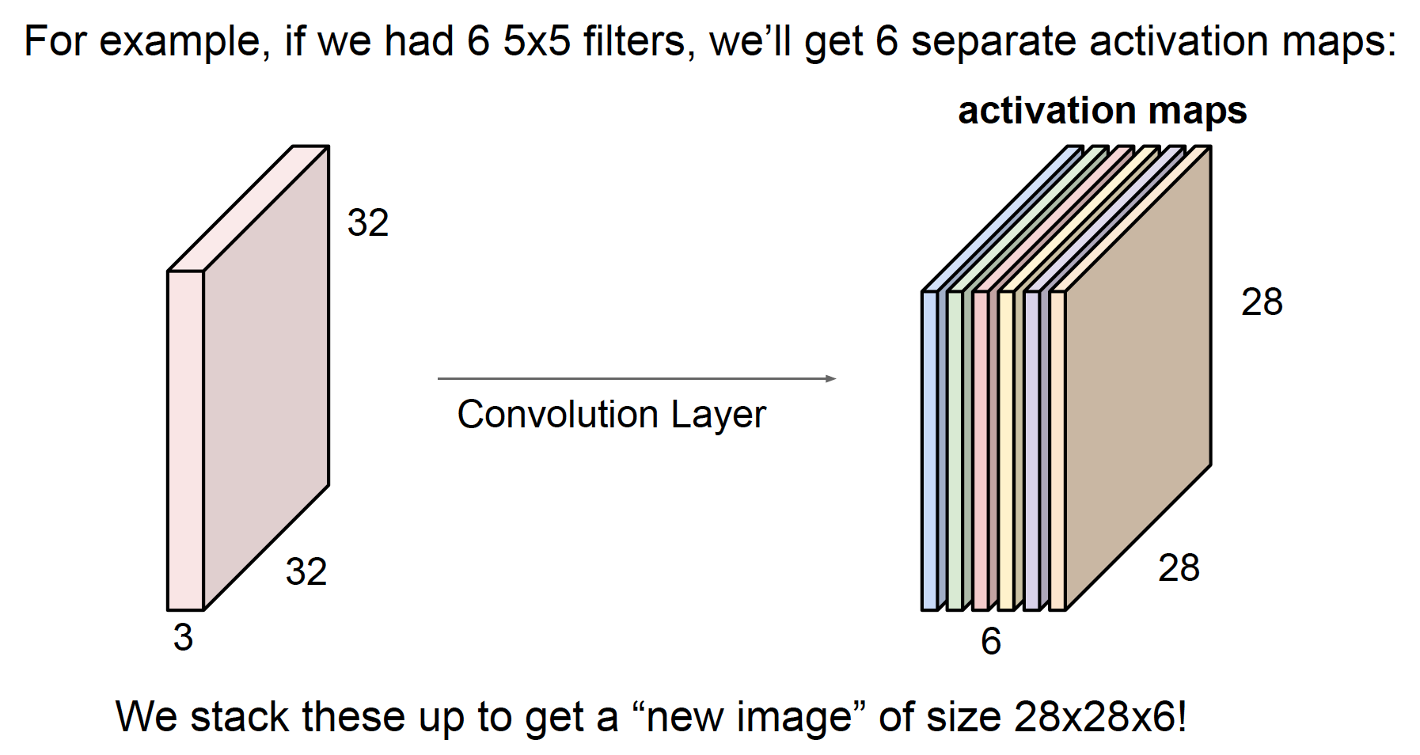
Convolution neural networks

Slide 43
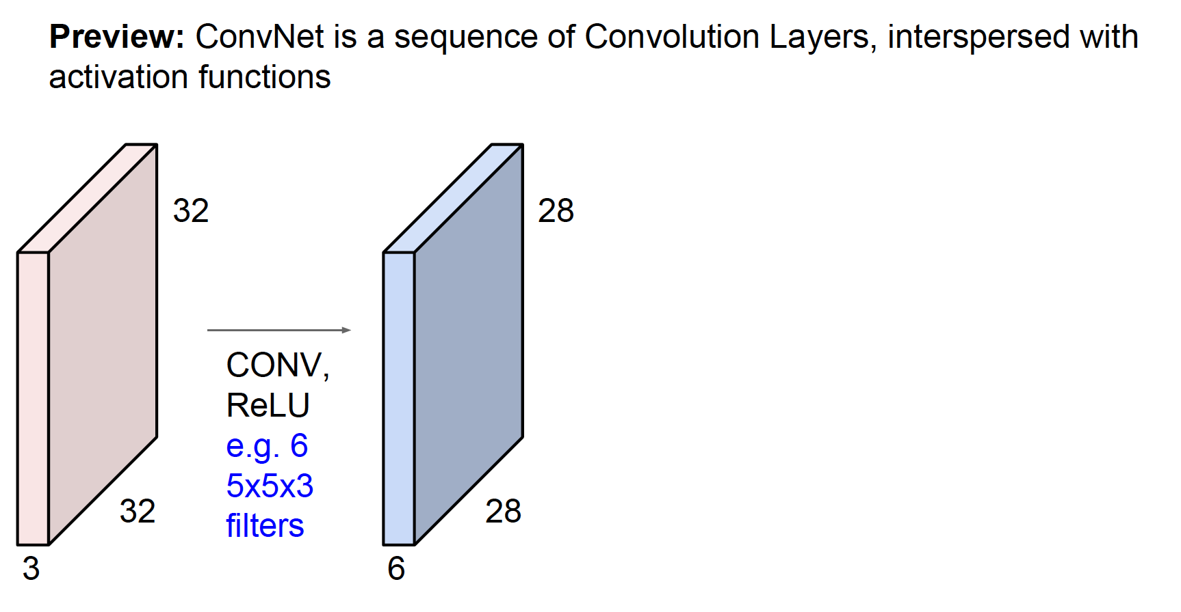
Convolution neural networks

Slide 44
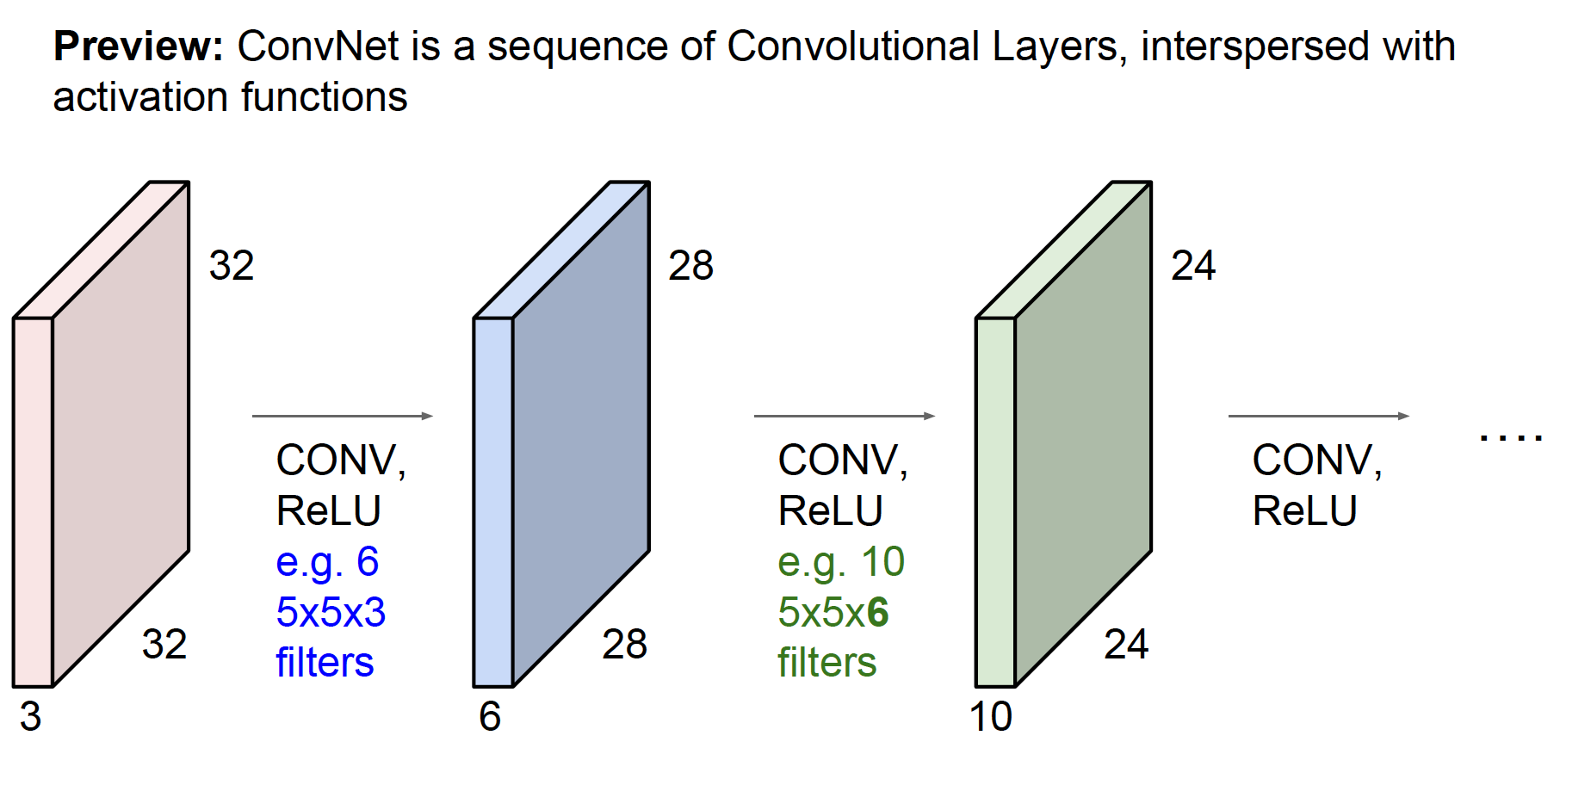
Convolution neural networks
Aside question: what choices do we have for non-linearity functions, besides ReLU?

Slide 45
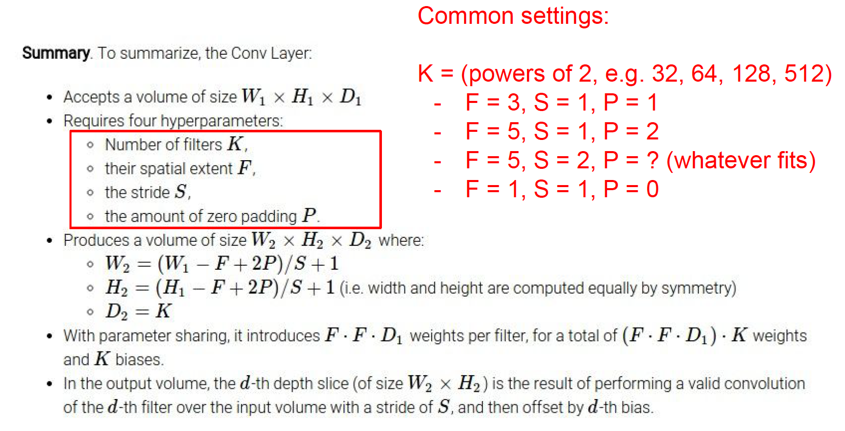
Convolution neural networks - Summary

Slide 46
CNN in PyTorch
>>> # With square kernels and equal stride >>> m = nn.Conv2d(16, 33, 3, stride=2) >>> # non-square kernels and unequal stride and with padding >>> m = nn.Conv2d(16, 33, (3, 5), stride=(2, 1), padding=(4, 2)) >>> # non-square kernels and unequal stride and with padding and dilation >>> m = nn.Conv2d(16, 33, (3, 5), stride=(2, 1), padding=(4, 2), dilation=(3, 1)) >>> input = autograd.Variable(torch.randn(20, 16, 50, 100)) >>> output = m(input)
http://pytorch.org/docs/stable/_modules/torch/nn/modules/conv.html#Conv2d
Notes:
Instructors can ask students to compute the output of these configurations

Slide 47
This Week's Outline
1. Introduction
2. Prerequisite to machine learning, optimization
3. Convolution neural networks
4. Useful softwares/tools/resources
5. Train an image classifier with PyTorch
6. Experiments and open discussions

Slide 48
Resources
If you want to dig up a little bit more:
AI and DL blogs by popular companies.
DeepMind: deep RL
Google: computer vision, language modelling
Facebook: computer vision
Uber, Clarifai, OpenAI, Salesforce, Nvidia, ...
AI and ML top-tier conferences:
CVPR, ICCV, ECCV
NIPS, ICML, ICLR
arXiv website
e.g., "feed forward and backward run in deep convolution neural network": https://arxiv.org/pdf/1711.03278.pdf
Social media
twitter: @goodfellow_ian, @ylecun, etc.
Medium: https://medium.com/
Must-know:
Stanford deep learning course: cs231n.
Deep learning textbook by Ian Goodfellow et al.
PyTorch tutorials and examples
Notes:
Instructors should extend this list above and introduce explicitly some of them if necessary.

Slide 49
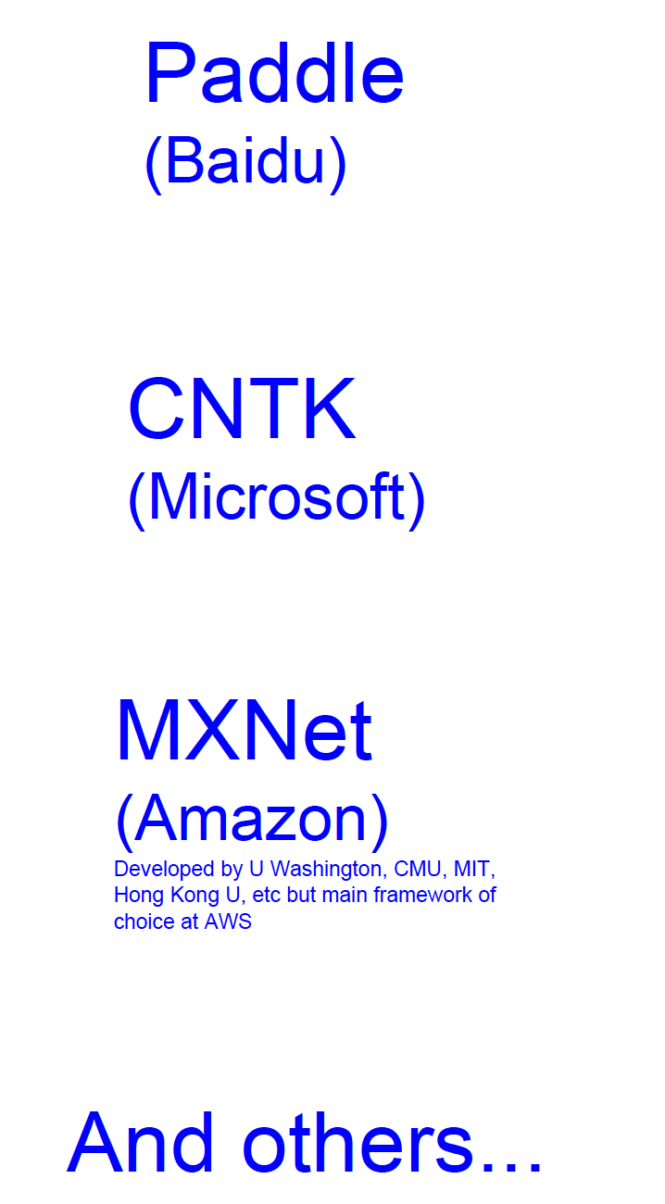
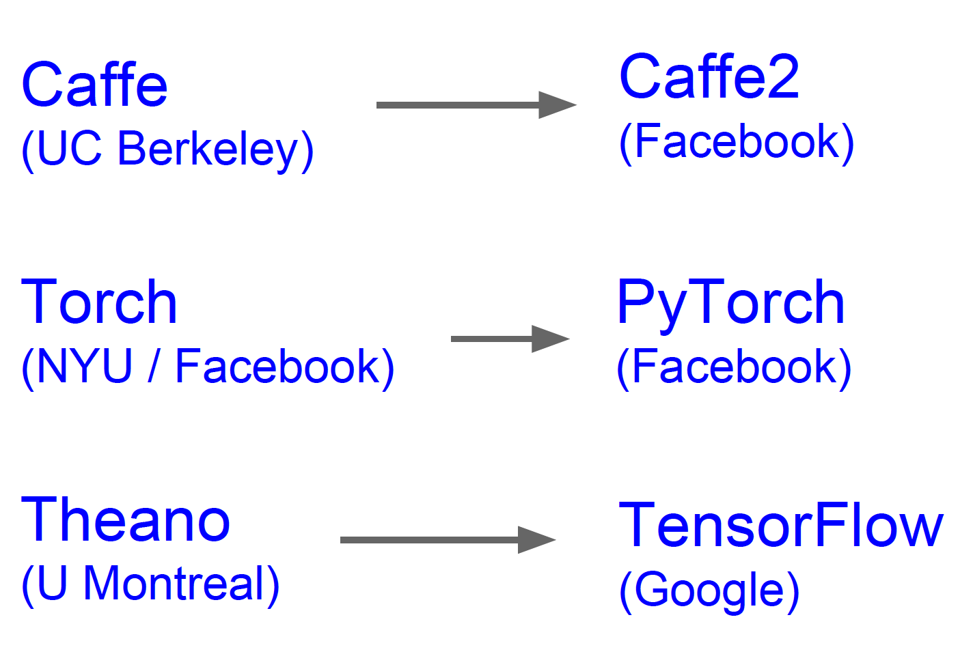
Deep learning softwares
Most popular ones

Slide 50
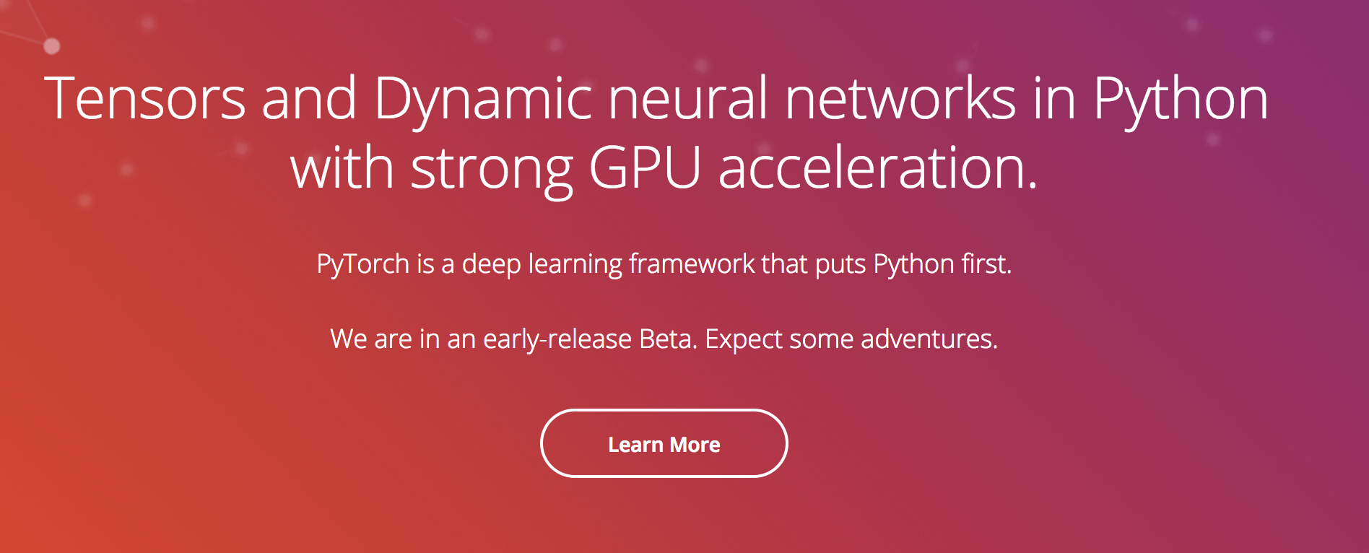
PyTorch: the most suitable software to design and deploy a deep learning model
For the rest time in the first session, we will walk through this beautiful deep learning toolkit.

Slide 51
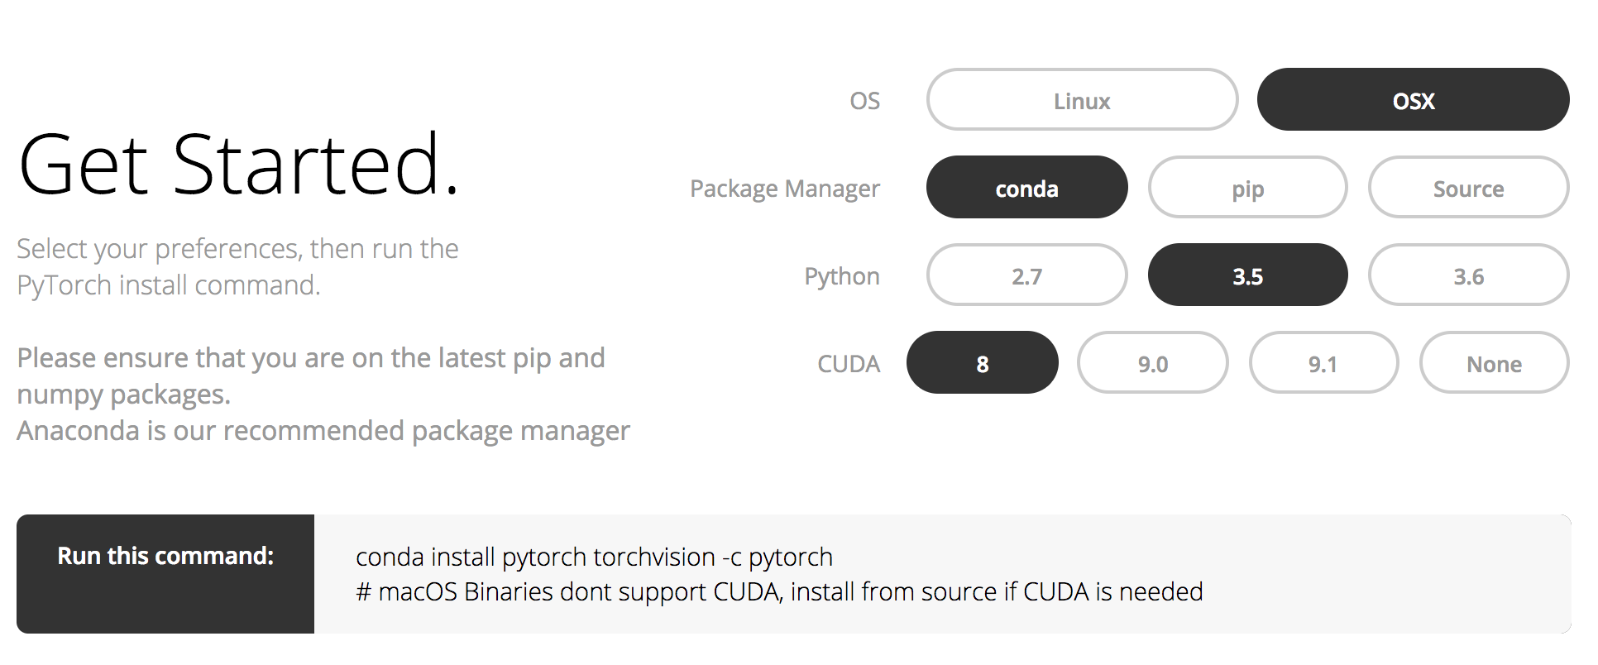
Open your laptop and install

Slide 52
Resources
Tutorials: http://pytorch.org/tutorials/
Examples: https://github.com/pytorch/examples
Documents: for example, convolution op. http://pytorch.org/docs/stable/nn.html#conv2d

Slide 53
Examples
http://pytorch.org/tutorials/beginner/pytorch_with_examples.html
This is a lightning walkthrough to have a quick sense of PyTorch.
We will have a further introduction to the key modules in the next session.
Notes:
Instructors should have a look at this example and teach students step by step.

Slide 54
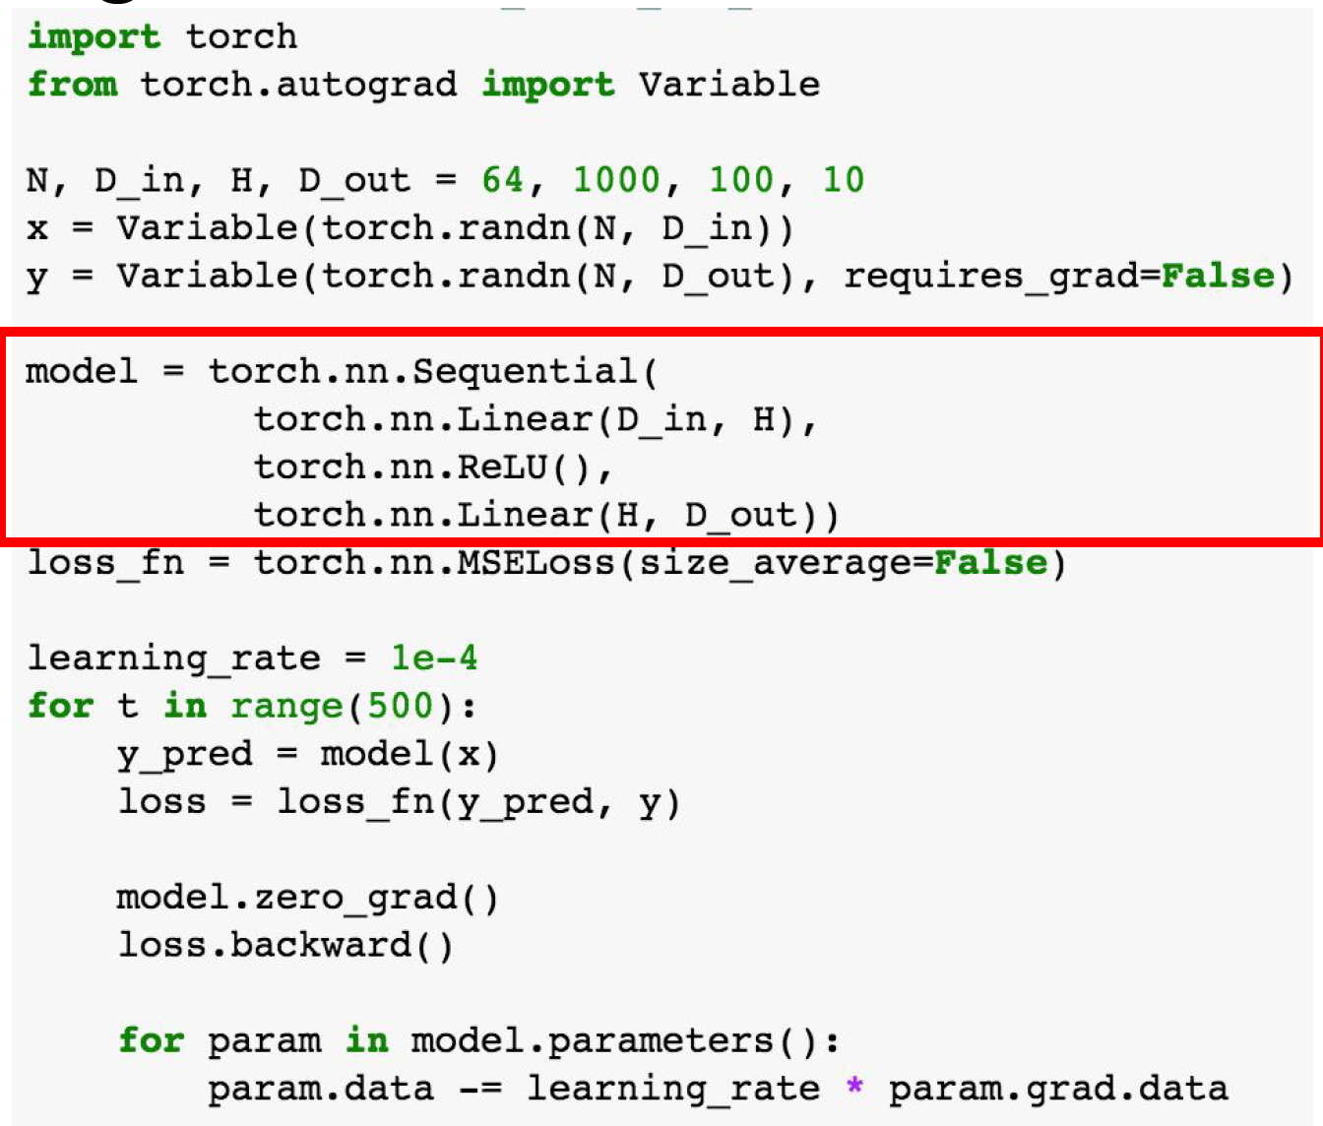
Examples
Try this out!
Define model structure as a sequence of layers --->

Slide 55
END of first session

Slide 56
This Week's Outline
1. Introduction
2. Prerequisite to machine learning, optimization
3. Convolution neural networks
4. Useful softwares/tools/resources
5. Train an image classifier with PyTorch
6. Experiments and open discussions
Notes:
Based on: http://pytorch.org/tutorials/beginner/blitz/cifar10_tutorial.html
Instructors should recap some of what’s been learned in the last session.

Slide 57
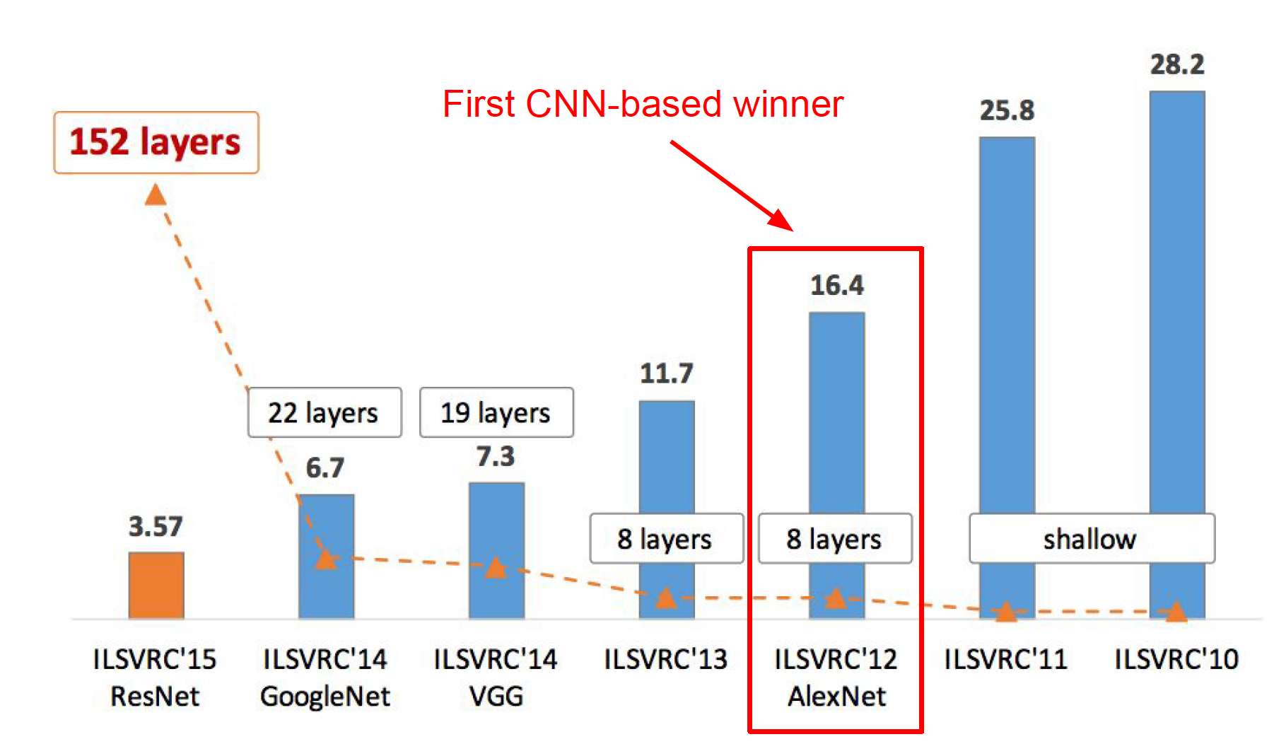
Overview of ImageNet challenge (image classification)
Numbers (16.4% in AlexNet) indicate error rate; lower is better.

Slide 58
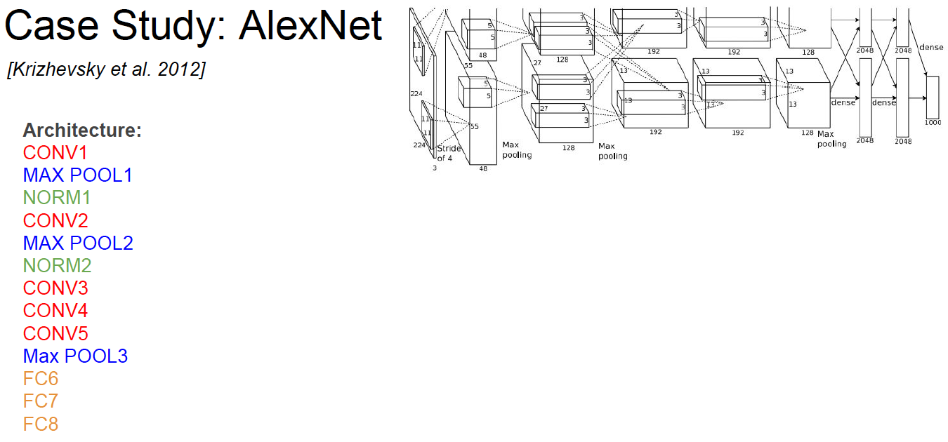

Slide 59
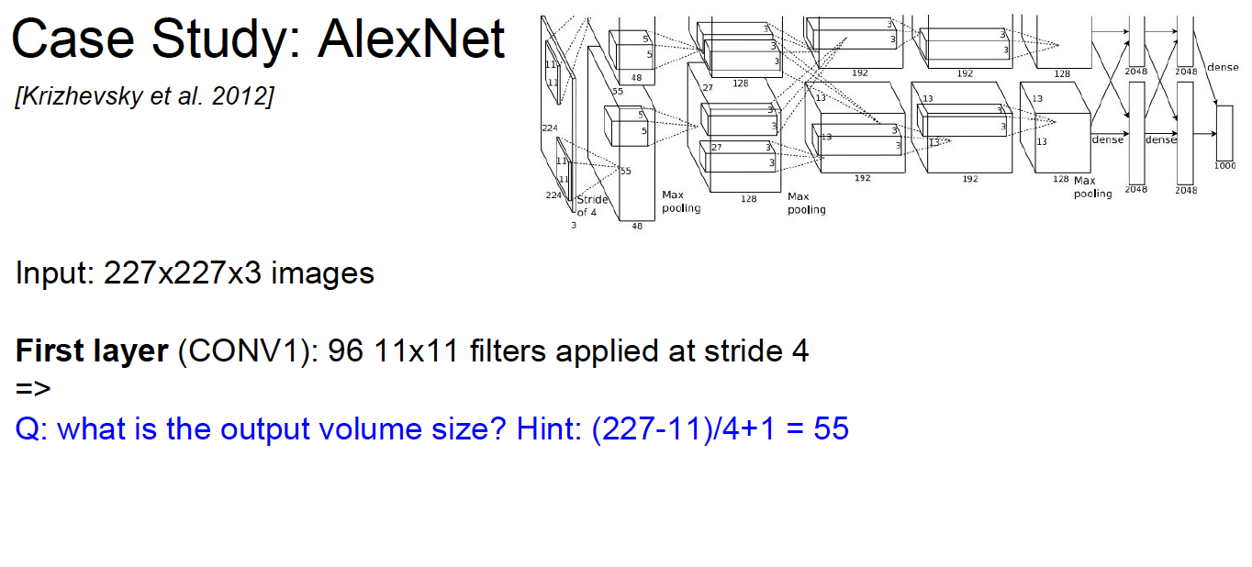

Slide 60
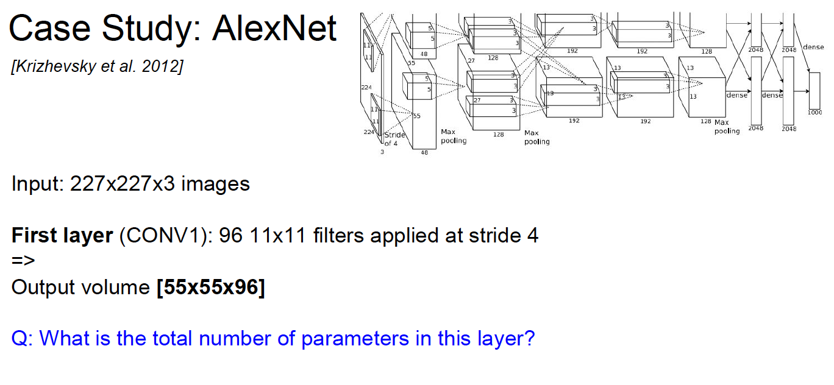

Slide 61
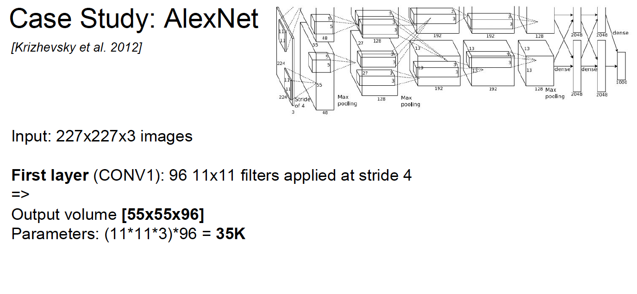

Slide 62


Slide 63


Slide 64


Slide 65


Slide 66


Slide 67


Slide 68


Slide 69


Slide 70


Slide 71
Now, build AlexNet in your pytorch environment!

Slide 72


Side slide: about normalization layer (LRN) in AlexNet
Goal:
to smooth the current layer from the response of other feature maps.
For details, see paper.
Why not used nowadays?
It doesn't improve performance that much; and is replaced by other regularization methods (BN, dropout, etc.)
Illustration
Notes:
if you have time, cover this; otherwise skip it.

Slide 73
The codebase is originally hosted at:
https://github.com/hli2020/alexnet-syngrad-pytorch/project1.ipynb
short url: https://goo.gl/1RV72L
For the rest part of this project, we will highly depend on the tutorial provided in the github repo above.

Slide 74
Training an image classifier
Steps:
1. Load and normalizing the CIFAR10 training and test datasets using torchvision
Know the different data augmentation skills and how they can improve/affect the results
2. Define a Convolution Neural Network
Build alexnet on your own; write customized LRN layer.
3. Define a loss function and optim method
We have a bunch of choices; which one is better?
4. Train the network on the training data
Get to know the workflow of any deep learning models
5. Test the network on the test data
This is where your model becomes applicable in real-world products
https://github.com/hli2020/alexnet-syngrad-pytorch/project1.ipynb

Slide 75

Load the data
No context here; follow the github tutorial and instructor's onsite explanation in class.

Slide 76
Define AlexNet (done)
No context here; follow the github tutorial and instructor's onsite explanation in class.

Slide 77
Define loss and optim method
No context here; follow the github tutorial and instructor's onsite explanation in class.

Slide 78
Train and test
No context here; follow the github tutorial and instructor's onsite explanation in class.

Slide 79
This Week's Outline
1. Introduction
2. Prerequisite to machine learning, optimization
3. Convolution neural networks
4. Useful softwares/tools/resources
5. Train an image classifier with PyTorch
6. Experiments and open discussions

Slide 80
Experiments and discussions
- Debug your model
what if the loss does NOT converge at the beginning?
- check your data; I am 90% sure on this. (take int type as float, size mismatch)
- change optim method (RMSProp, Adam, etc.) and loss type (cross entropy or others)
what if the loss enters into some plateau after several epochs?
- this implies "overfit" problem occurs.
- increase the data by augmentation (preferable)
- downsize the model capacity (reduce layers/parameters)
- change lr_scheme or init_lr and see over again
- for some tasks, it is ok to have the plateau if lr has been decreased once/twice after (e.g., object detection). The performance (mAP in object detection) will slightly increase.

Slide 81


Experiments and discussions
- Try different components
Choices in PyTorch:
or you can implement them on your own; see some of source codes below to get a sense.
how about change the form of non-linearities instead of ReLU?
MORE importantly, why do we need to insert ReLUs
between layers?
Notes:
If there is no Relu, based on the linear theorem, no matter how many layers you stack; it is just one single linear layer: y = Wx + b. Inserting non-linearities, we preserve the "depth" (thus representation/capacity) of the network.

Slide 82
Experiments and discussions
- Try different components
There are so many aspects to be investigated; by changing them, you can have a clue which of them is minor to change a little bit; other for other factors, alternating from 0.1 to 0.01 (learning rate) could vary a lot in performance.
For example:
- learning rate
- optim method
- add BN
- remove dropout in FC layers
- ...
Notes:
If there is no Relu, based on the linear theorem, no matter how many layers you stack; it is just one single linear layer: y = Wx + b. Inserting non-linearities, we preserve the "depth" (thus representation/capacity) of the network.

Slide 83
Experiments and discussions
- Compare GPU vs CPU
The very beauty of deep learning is the use of GPU hardware! Accelerate the training time in a magical fashion.
Compare the time deployed in GPU and CPU mode to get a sense!

Slide 84

Extensions
If there is time left for you, consider the following interesting follow-ups:
Try other fascinating structures! especially resNet! For an overview, see the blog post.

Slide 85
Google Cloud AutoML
https://codelabs.developers.google.com/codelabs/cloud-automl-vision-intro/#0
View Google Cloud Service at GTC 2018.
Notes:
Instructors can introduce this cloud service to students if there is still enough time; otherwise put it in the second project.

Slide 86
END
Coming up: RNNs and applications in sequence data

